Slide 1

Team ‘E’
Web Scraping: Extracting Car Data from Cars24
This presentation outlines a web scraping project aimed at extracting car details from the Cars24 website. The project leverages Python libraries like requests and BeautifulSoup to automate the data extraction process, offering valuable insights into the automotive market.

Slide 2


Project Setup and Environment
1
Install Libraries
The project begins by setting up the development environment. Essential Python libraries, including requests, BeautifulSoup, and pandas, are installed. These libraries provide the necessary tools for web scraping, HTML parsing, and data manipulation.
2
Website Inspection
Thorough inspection of the Cars24 website is crucial. This involves identifying HTML tags and classes associated with the target data. This step ensures that the scraper can accurately extract the desired information.
3
Scraper Development
A Python script is crafted to fetch and parse the HTML content of the Cars24 website. This script leverages BeautifulSoup to extract car details based on the identified tags and classes.
4
Data Organization and Export
The extracted data is organized into a structured format, such as a Pandas DataFrame. The data is then exported to a CSV file for further analysis and visualization.

Slide 3

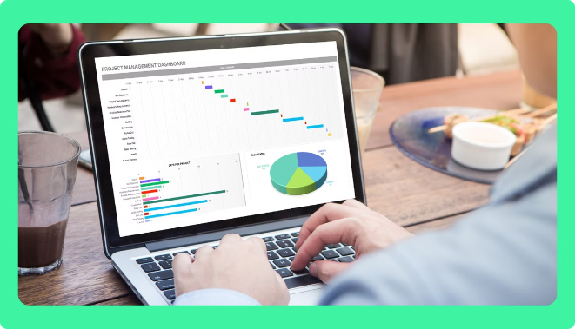
Methodology and Data Sources
Definition
Web scraping involves the automated process of extracting data from websites. It uses tools and techniques to retrieve information and convert it into a structured format for analysis.
Data Sources
The data source for this project is Cars24. The project focuses on Ford cars available in Mumbai and Delhi. This localization ensures relevant and valuable insights into the market in these specific regions.
Tools Used
Common web scraping tools include Python libraries like requests and BeautifulSoup. These libraries provide functions for fetching web content, parsing HTML structures, and extracting data.
Applications
Web scraping has diverse applications, including data mining, market research, price monitoring, and competitive analysis. It enables businesses to gain valuable insights from publicly available online data.

Slide 4


Challenges in Web Scraping
1
Dynamic Content
Websites often utilize JavaScript and other technologies to dynamically load content. Handling dynamic content poses a challenge, as traditional scraping methods may not capture the complete information.
2
Request Limits
Web scraping should be conducted responsibly to avoid overwhelming websites with excessive requests. Websites often implement rate limits to protect their resources and prevent abuse.
3
Legal and Ethical Guidelines
Web scraping must adhere to legal and ethical guidelines. It's essential to respect website terms of service, robots.txt files, and privacy policies. Avoid scraping sensitive data or engaging in activities that could harm websites or their users.
4
Data Cleaning and Validation
The scraped data may contain inconsistencies, errors, or missing values. Data cleaning and validation processes are crucial to ensure the accuracy and reliability of the extracted information.

Slide 5
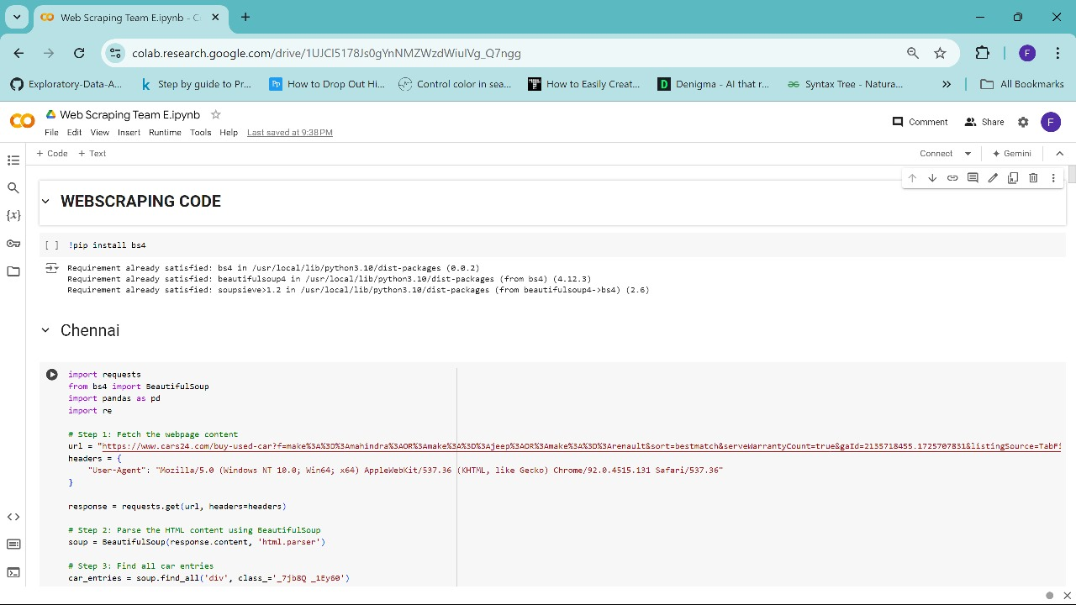
Code Implementation: Extracting Car Details:
Code to extract data for each location, like wise we have done for 10 locations.
Model
Kilometers Used
Fuel Type
Car Type
Service
EMI
Price
Location
Ford Figo
27,102 km
Petrol
Hatchback
6 months
₹10,956/month
₹5.87 Lakh
Mumbai
Ford Aspire
45,779 km
Petrol
Sedan
3 months
₹8,956/month
₹4.27 Lakh
Mumbai
Ford EcoSport
79,659 km
Diesel
SUV
12 months
₹12,956/month
₹6.52 Lakh
Mumbai

Slide 6
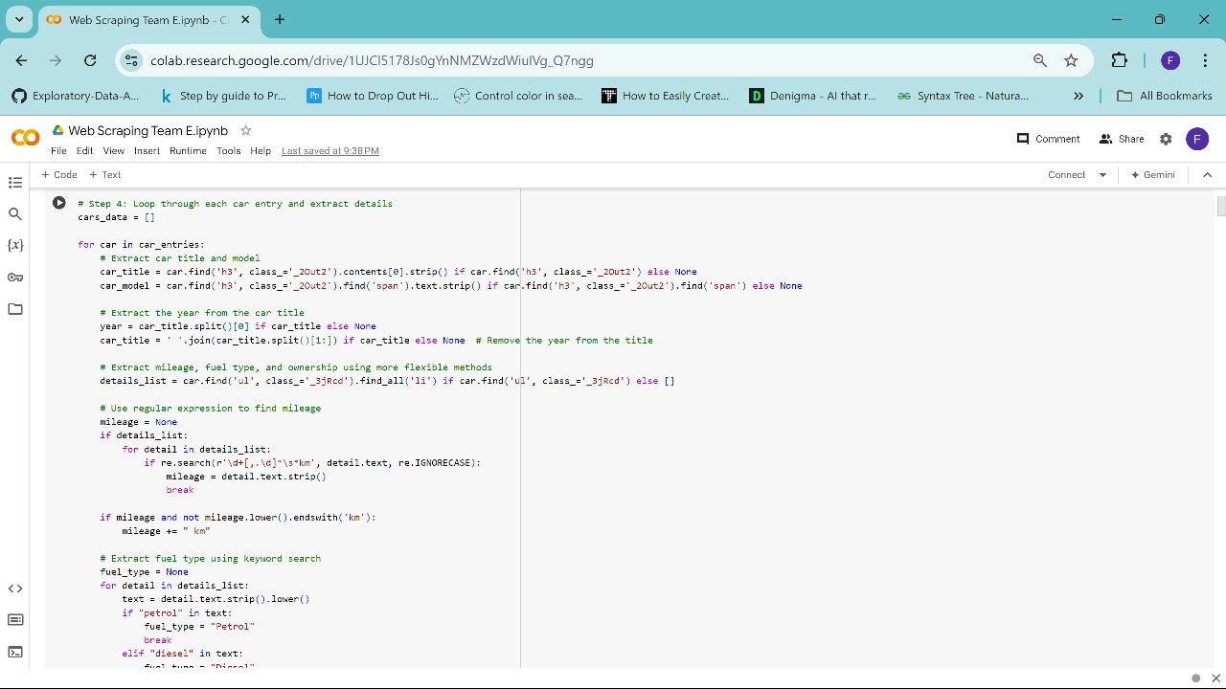

Slide 7
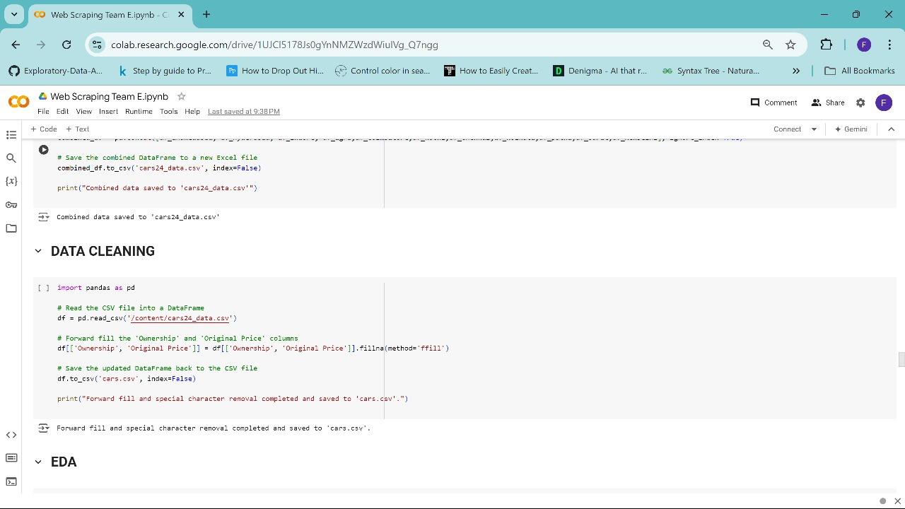

Slide 8
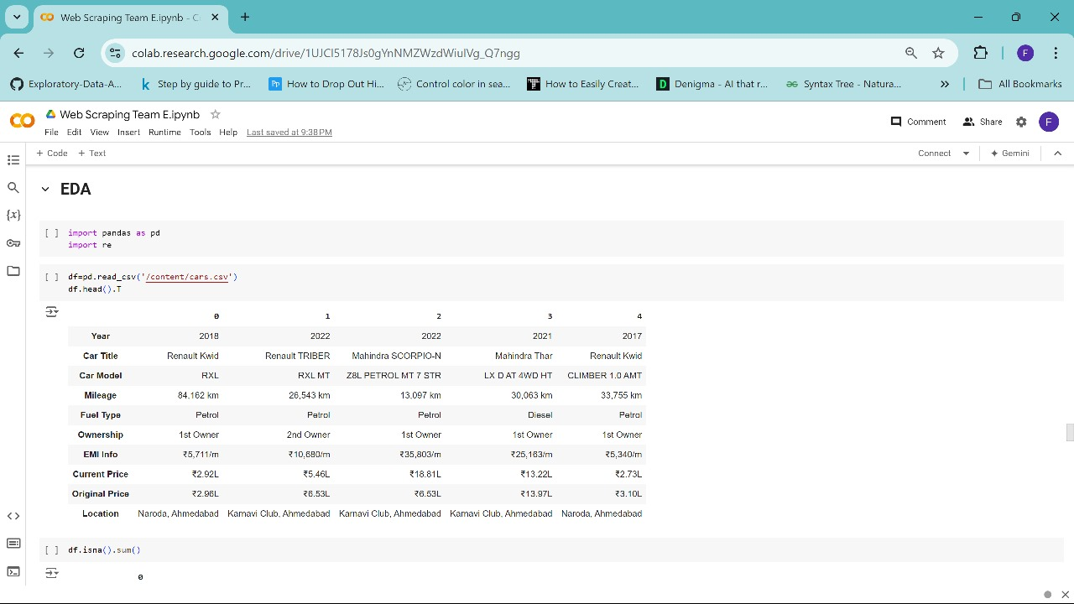

Slide 9
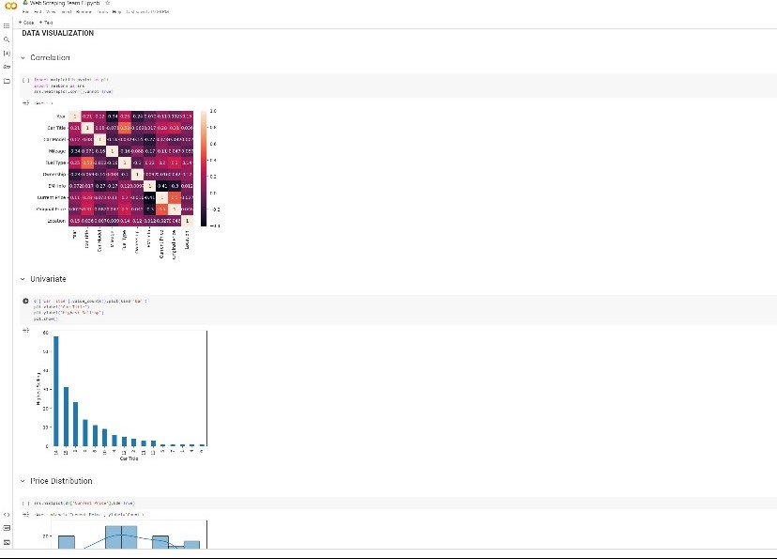

Slide 10
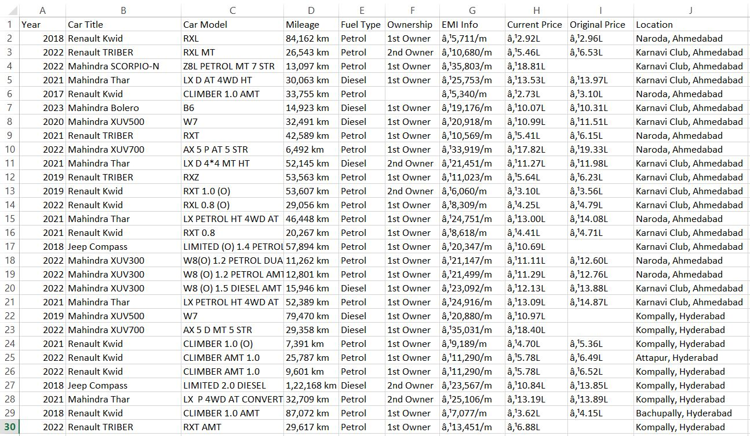
Output:- .CSV file without Data Cleaning.

Slide 11
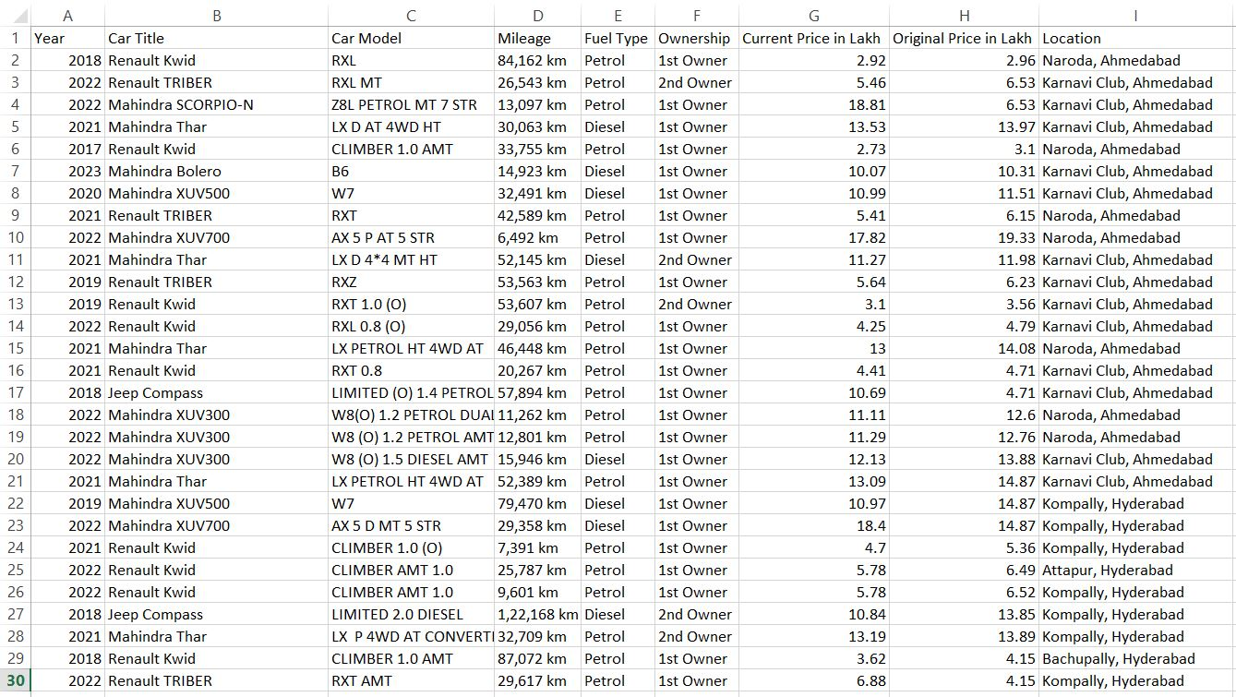
Output:- .CSV file with Data Cleaning.

Slide 12


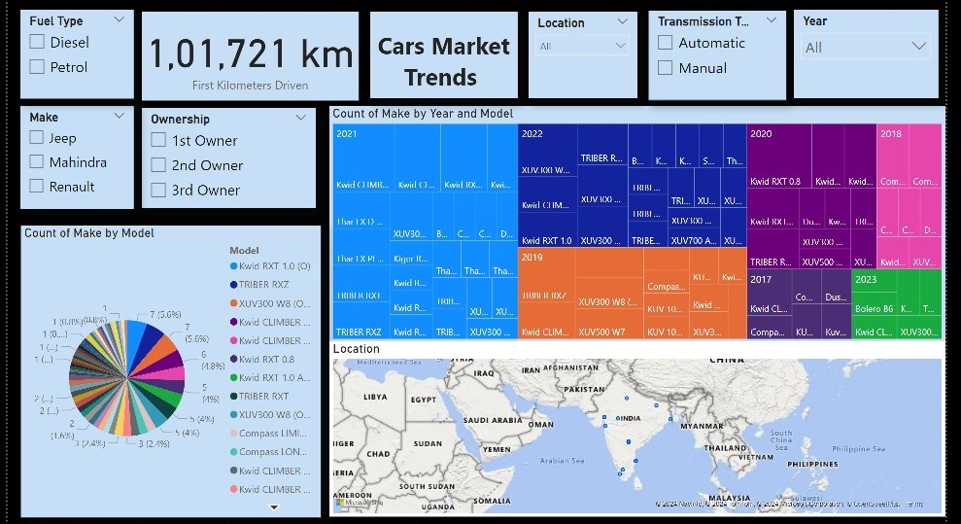


Data Analysis: Unveiling Market Trends
Data Cleaning
Before analysis, the extracted data is cleaned and processed. This involves converting data types, removing inconsistencies, and handling missing values. This ensures accurate and reliable results.
Data Visualization
Visualizing the data provides a clear understanding of trends and patterns. Histograms, scatter plots, and count plots are used to analyze the distribution of kilometers driven, year of manufacture, fuel type, transmission, and price.
Insights and Observations
Analyzing the visualized data reveals valuable insights into market trends, pricing patterns, and consumer preferences. This information can inform business decisions related to inventory management, marketing strategies, and pricing strategies.

Slide 13
Key Takeaways: Insights from the Data
Market Trends
Pricing Patterns
Consumer Behavior
The analysis reveals the popularity of certain Ford models, fuel types, and transmission options in Chennai and Other Location. This information helps businesses understand consumer preferences and tailor their offerings accordingly.
The data reveals pricing trends based on kilometers driven, year of manufacture, and other factors. This information can be used to set competitive prices and adjust pricing strategies to optimize profitability.
The analysis provides insights into the preferences and behavior of potential car buyers in Chennai and Other Location. Understanding consumer behavior helps businesses develop targeted marketing campaigns and enhance customer satisfaction.

Slide 14


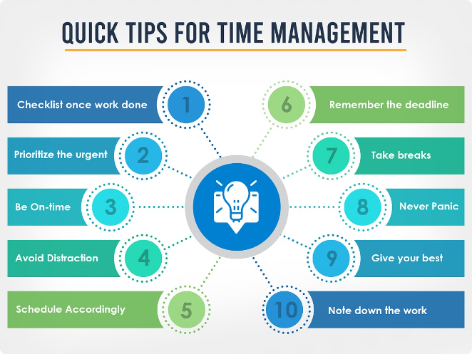


Time Management Strategies: Optimizing the Process
Efficient Scripting
Optimized scripts are developed to reduce scraping time and improve data extraction efficiency. This involves utilizing efficient algorithms, minimizing redundant code, and optimizing data processing techniques.
Parallel Processing
Parallel processing techniques are implemented to accelerate the scraping process. By running multiple scripts simultaneously, the time required to collect data is significantly reduced.
Data Storage Optimization
Efficient data storage solutions are employed to minimize storage overhead and facilitate data analysis. Relational databases or cloud storage options are used to manage large datasets effectively.

Slide 15
Conclusion: Harnessing Data for Informed Decisions
This web scraping project demonstrates the power of data extraction and analysis. By leveraging Python libraries and techniques, valuable insights into the automotive market are extracted from Cars24. These insights empower businesses to make informed decisions related to pricing, inventory management, and marketing strategies, ultimately leading to enhanced profitability and customer satisfaction.

Slide 16
Thank You!
We would like to extend our sincere gratitude for your time and attention.
Team Members:
Web Scraping -
Fathima Dilshana PK
Saravanan P
Abhishek Singh
Data Cleaning and Predictive analysis Model -
Uthra Nitheya CG
Data Visualization –
Sakshi Vijay Mindhe
Anand Eswar
Kiranbabu P
Presentation Making –
Dinesh Solanki
Project Report Making –
Mehar Snotra
Ajay Krishnan M

